Slide 1
Introduction to the Cloud

Slide 2

Overview
What is a Server?
The Anatomy of a Datacenter
The Anatomy of the Internet
Software Stack
The Cloud
Infrastructure as a Service
Platform as a Service
Business models
Public vs. Private Cloud
Automation
Regulation

Slide 3
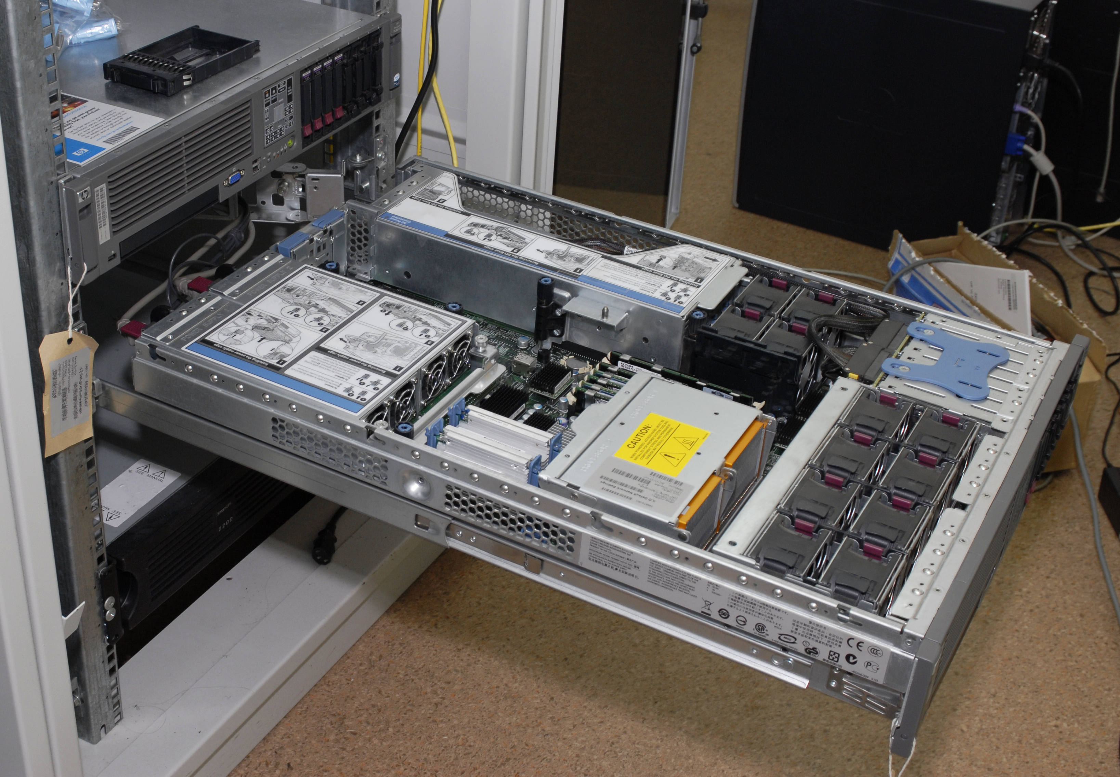
What is a Server?

Slide 4
CPU Architectures
SPARC
x86
X86_64
PowerPC
ARM
1986
1987
1992
1996
2003
2008
2011
2019
2020

Slide 5
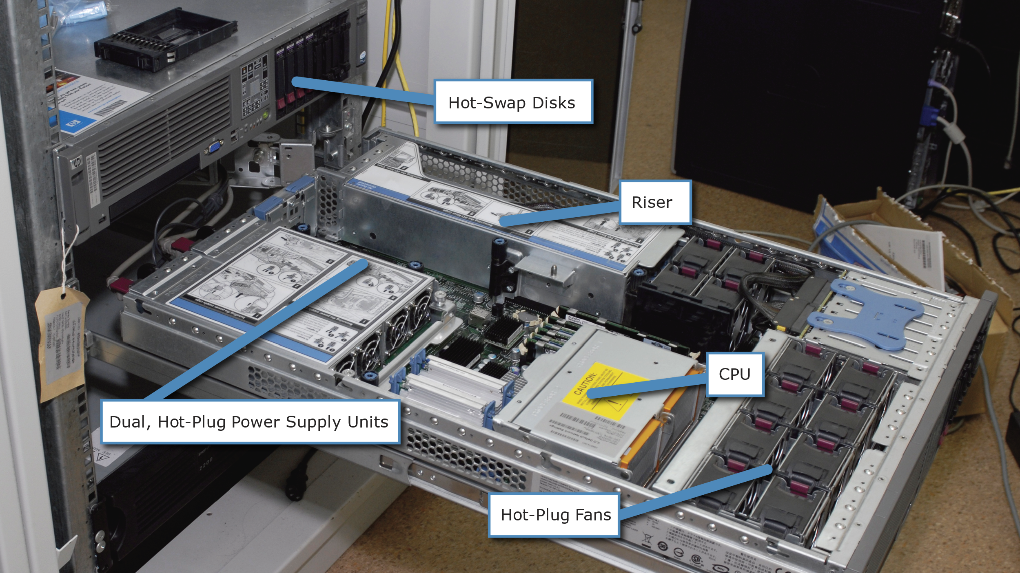
Server builds

Slide 6
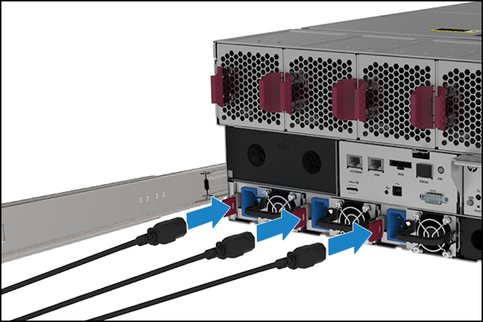
Redundant Power Supply
PLACEHOLDER IMAGE

Slide 7
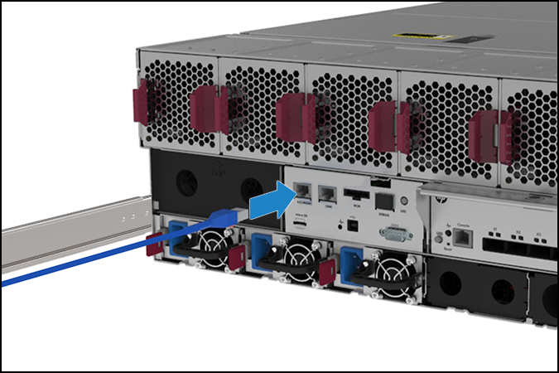
Out Of Bounds Management
PLACEHOLDER IMAGE

